Slide 1
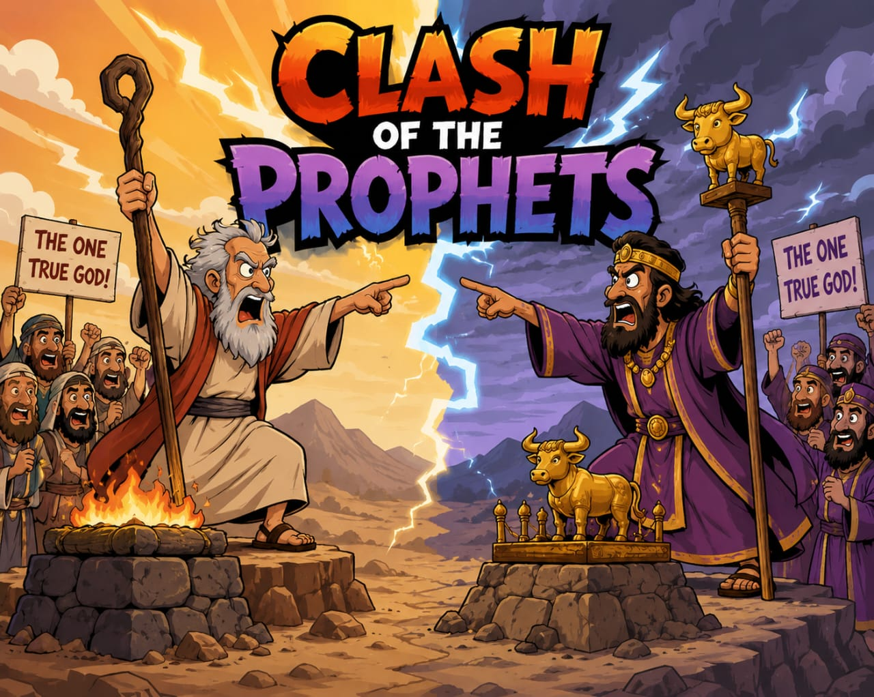

Slide 2
CLASH OF THE PROPHETS
Text: 1 Cor. 14:33, 2 Tim. 3:15-17, Matt. 24:24
The Lord Jesus said that there will be many false prophets at the end time.
A preacher in the new testament fits into the office of a prophet, because he is giving out the word of God.
The bible reveals several stories that show the clash of prophets
Meaning of clash opposition or contradiction, or to come into violent conflicts etc.

Slide 3
Definition: whenever there is contradiction of prophecies, we have a clash of prophets

Slide 4
STORY 1 JEREMIAH AND HANANIAH
The Clash – Jeremiah 28 : 1 - 11
The result – Jeremiah 28 : 12 - 17
STORY 2 THE YOUNG PROPHET AND THE OLD
1 Kings 13:1-10 – The original prophet
1 Kings 13 : 11 – 32 – The encounter with the old prophet

Slide 5
STORY 3 Micaiah and the 4000 prophets
1 Kings 22 : 1 – 12 – The lying prophets
1 Kings 22 : 13 – 28 – Micaiah’s prophecy
1 Kings 22 : 29 – 38 – The fulfilment

Slide 6
LESSONS
The clash of prophets reveals that the prophets are not receiving from the same source. James 3 : 12, 1 Cor. 14 : 33
The clash of prophets reveals that genuine prophets can prophesy by a lying spirit – for example; Ahab’s prophets (1 Kings 22) 1 John 2:18-21, 1 John 4:6, 2 Cor. 11:4, 2 Thes 2:13

Slide 7
The clash of prophets reveals that a prophet can prophesy from himself. For example, Hananiah (Jeremiah 28) Gal. 1 : 6 - 9, 2 Peter 2 : 1 - 2, Jude 1: 3-4
The clash of prophets reveals that a prophet can give both a true prophecy and a lying prophecy. For example, the old prophet at Bethel (1 Kings 18)
The clash of prophets also reveals that only the true prophecies will be fulfilled when two or more contrary prophecies are given.

Slide 8
CONCLUSION
This is exactly the condition of the church today
Ephesians 4 : 4 – 6 was possible when there was no clash of prophets
The different versions of the gospel presented today reveals that there is a clash of prophets.
But only the true gospel will be vindicated, only the true prophecy will be fulfilled.
Your prophet is your profit or your loss which prophet are you following?

