Slide 1
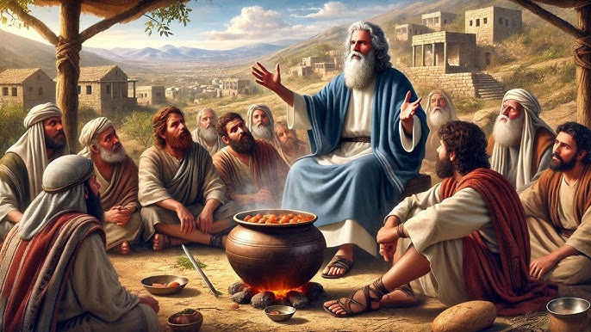
DEATH IN THE POT

Slide 2
Rom. 15:4, 2 Tim. 3 :15-17 – Old Testament stories are not just historical, they are sometimes prophetic and hold many lessons for us in this generation.
One of such stories is the story about the death in the pot: 2 kings 4 : 38-41

Slide 3
Elisha – Holy spirit
Sons of the Prophets – The believers
Servants – Fivefold ministry
Pottage – The word of God
Gilgal – The beginning of our spiritual walk (2 kings 2:1)
Wild vine – Error

Slide 4
Death – Spiritual hunger (Jesus came to fill John 6:33-35)

Slide 5
Verse 39: fulfilled in A.D. 325. Matt. 13:33 – corrupting the word of God. Poison/error was injected into God’s word through the Roman Church in A.D. 325.

