Slide 1
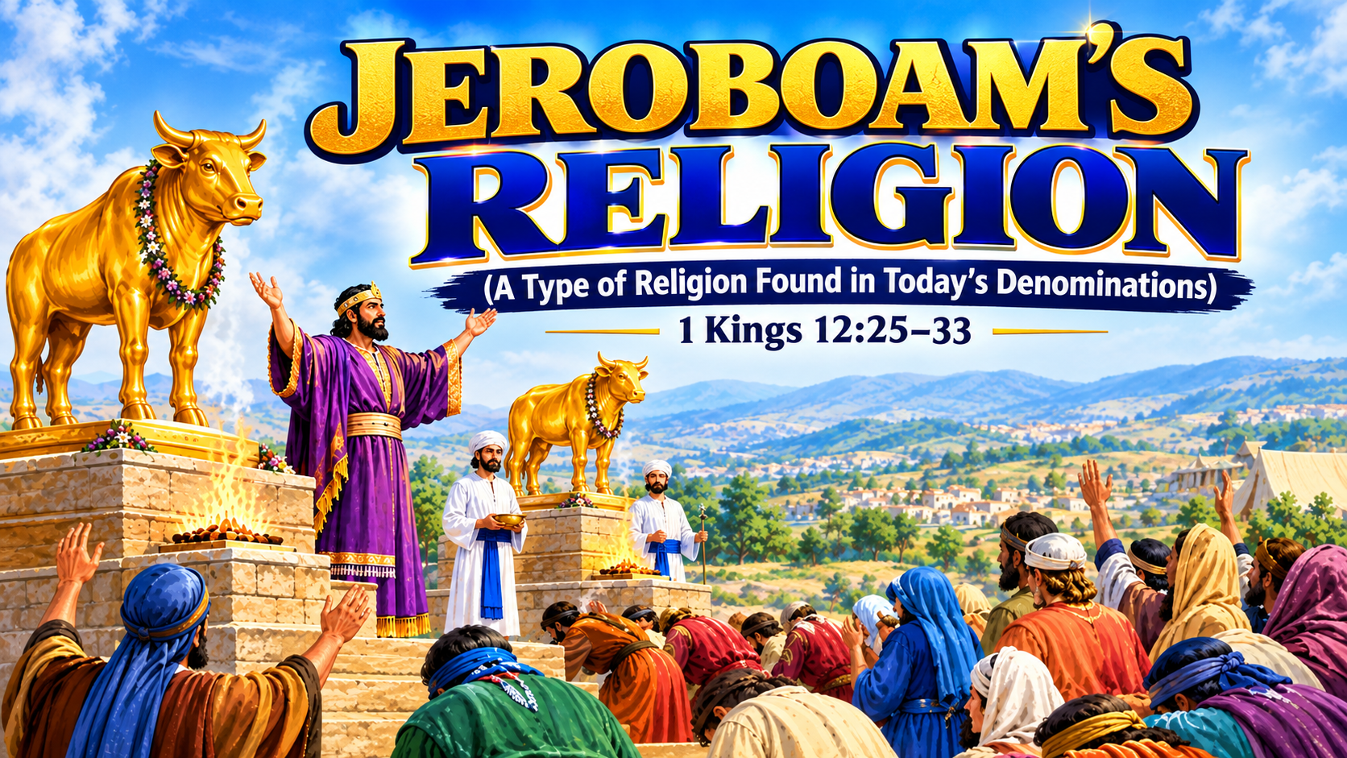

Slide 2
A. INTRODUCTION
What is Religion?
Religion is a system of beliefs, teachings, practices, and forms of worship through which people seek to understand, relate to, and serve a deity or spiritual reality.
A false religion is a system of religious beliefs, teachings, worship, or practices that leads people away from God's truth and contradicts His revealed will.

Slide 3
Who was Jeroboam?
The Background of Jeroboam: Jeroboam was the son of Nebat, an Ephraimite who served under King Solomon. He was a mighty man of valour and a servant of Solomon.
His name: Jeroboam, son of Nebat.
His tribe: Ephraim.
His kingdom: The northern kingdom of Israel, consisting of ten tribes.
His predecessor: Rehoboam, who remained king over Judah.
His biblical story: 1 Kings 11–14.

Slide 4
B. JEROBOAM’S RELIGION
Jeroboam forsook God’s established pattern of worship and established his own religious system.
He established the following:
1. Golden calves - The introduction of idols. (1 Kgs. 12:28)
Jeroboam introduced golden calves for the people to worship. However, God had commanded Israel not to make or worship graven images. (Exo. 20:3–5; Exo 32:1-8)

Slide 5
B. JEROBOAM’S RELIGION
2. New places of worship - Bethel & Dan (1 Kgs. 12:28–29)
God had chosen Jerusalem as the place where His name would dwell and where Israel was to bring their offerings and sacrifices according to His law. Deut. 12:5-6; 2 Chro. 6:6
3. A different priesthood - He appointed priests outside God's prescribed order (1 Kings 12:31)
God had appointed Aaron and his descendants to serve as priests under the Law. The Levites were also set apart for particular duties associated with the tabernacle and Israel's worship. (Exodus 28:1; Num. 3:5–10; Num 18:1–7)

Slide 6
B. JEROBOAM’S RELIGION
4. A different feast — Changing God's appointed time (1 Kgs. 12:32–33)
God had appointed specific feasts (Lev 23) for Israel, including the Feast of Tabernacles, (Lev 23:34) which was to be observed in the seventh month. God did not leave Israel to invent its own calendar of appointed feasts at will. He gave instructions about when these sacred occasions were to be observed.

Slide 7
B. JEROBOAM’S RELIGION
5. A different altar and sacrificial system (1 Kgs. 12:32–33)
Under the law, God gave Israel instructions concerning sacrifices, offerings, and the place where these were to be presented. God also gave detailed instructions concerning the altar and the offerings.
(Exo. 27:1–8; Lev. 1; Deut. 12:13–14)

Slide 8
C. TODAY’S DENOMINATIONS’ RELIGION
Today's denominations, instead of following the steps of the apostles and continue steadfastly in their doctrine because the church is built on the foundation of the apostles and the prophets (Acts 2:42; Eph. 2:20), they, like Jeroboam, have gone to establish their own religion.

Slide 9
C. TODAY’S DENOMINATIONS’ RELIGION.
The following practices are examined in this study:
1. Trinity:
God is torn into three distinct personalities contrary to the true revelation. (Deut. 6:4; Mark 12:28-29; Jn. 14:9; Rev. 1:8, Eph.4:5-6, Rev. 4:2)
2. Baptism:
Baptism is done in the titles of the Father, Son and Holy Ghost contrary to the formula. (Acts 2:38, Matt. 3:17, Col. 3:17, Isa. 42:8)

Slide 10
C. TODAY’S DENOMINATIONS’ RELIGION
3. Appointment of pastors: Preparing and appointing their five-fold ministers through Bible school contrary to heavenly pattern in Ephesians 4:10-11.
4. Observance of unscriptural feast: Celebration of Christmas, Easter, Valentine while rejecting or downplaying the main feast (Communion) we are commanded to keep (1 Cor. 5:7-8, 1 Cor.11:23-24)
5. Woman pastor: Ordaining women into the leadership offices in the church contrary to the due order. (1 Tim 2:11, 1 Cor 14:34, 1 Cor 11:3, 1 Cor 14:34-35)

Slide 11
D. THE DANGER OF DEPARTING FROM GOD’S ESTABLISHED WAY OF WORSHIP
1. Vain Worship. Worshipping God Without His Approval. (Mark 7:7–9; Matthew 15:8-9, Matt. 7:22-23)
2. It leads to sin and death. (1 Kgs. 12:30; 1 Kgs. 14:16, 2 Sam. 6:7)
3. It leads to the doctrines of devils. (1 Tim. 4:1; 2 Tim. 4:3-4)
4. It leads to Worldliness. (James 4:4; 1 Jn. 2:15–16; Rom. 12:2)
5. It leads to Spiritual Blindness and Deception. (Matt.15:14, Matt. 24:24)

Slide 12
E. THE WAY BACK
It is restoration, coming back to the word.
Consider the example of King Josiah. When the Book of the Law was discovered, Josiah realized that the kingdom had departed from God’s instructions.
2 Kgs. 22-23
When God’s people discover that they have departed from the original pattern, the answer is restoration through a return to God’s Word and obedience to His instructions.

Slide 13
CONCLUSION
The church must earnestly contend for the Faith Once Delivered.
(Jude 1:3; 2 Cor 6:17-18; Rev 18:4; Gal 1:8-9)

Slide 14
SHALOM!!!

