Slide 1
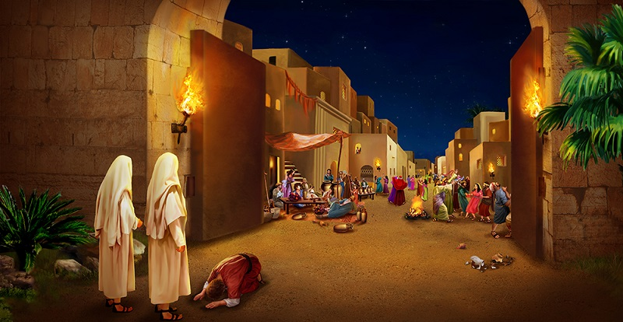
THE ANGELS THAT CAME TO SODOM

Slide 2
Luke 17 : 26 – 30
There are two generations in the bible that give a picture of the endtime:
Noah’s generation
Lot’s generation

Slide 3
Sodom is any society or generation that is completely sinful and in total rebellion against God. Several scriptures about Sodom:
Gen. 13:13, Deut. 32:32, Isaiah 3:9, Ezek. 16 : 46-56 -describing Sodom as a very sinful society.
...continue

Slide 4
Isaiah 1:9, Isaiah 13:19, 2 Peter 2:6, Jude 1:7, Jer. 50:40 – as a society set out for divine judgment

Slide 5
(1)
Two angels visited Sodom: Gen. 19:1
(who were these angels? God’s righteousness for that day – Gen. 18:23-28 ...... – Everyone saw them)

Slide 6
Lot received those two angels and fellowshipped with them (Gen. 19:1-3)
The men of Sodom rejected them, desecrated them and even abused them (Gen 19:4-5)
Lot contended for the angels (Gen.19:6-7)

Slide 7
Lot was persecuted for their sake (Gen. 19:9)
The angels show Lot the way of salvation and compelled him out of Sodom – Gen. 19:10-24

Slide 8
Who are these angels? Angel means messenger, one carrying a message, they are old testament and the new testament, the totality of God’s word (Ephe. 2:20) bearing God’s message to us today.

Slide 9
INSERTING THE WORD
Accepting / receiving the angels (The Word) makes us righteous – e.g Esther 2:15 – fellowship with the Word
The men of Sodom rejected the word, abused the word, dishonoured the word (Angels) and they were condemned.

Slide 10
3) The righteous will contend for the angels (word). Jude 1:3
The righteous will be persecuted for the angels (word). Matt.13:21
The angels (word) will show the way of salvation and will compel us out of Sodom. Psalm 119:105

Slide 11
6) Those that will turn back will be like lots wife.

