Slide 1
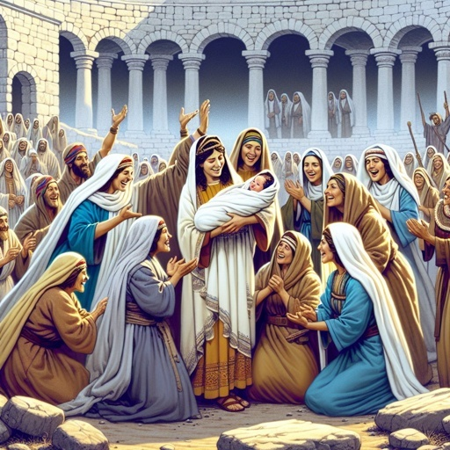
THE BRINGING FORTH OF OBED

Slide 2
THE BRINGING FORTH OF OBED
INTRODUCTION
2 Timothy 3 : 15 – 17
1 Cor. 10 : 6
Rom. 15 : 4
Stories in the old testament teach us great lessons in the new testament

Slide 3
THE BRINGING FORTH OF OBED
Obed was the son of Ruth whom she bore to Boaz
Ruth the Moabites, left in abject poverty was redeemed by Boaz the mighty man of wealth
Ruth is a type of the Bride
Boaz a type of Christ the kinsman redeemer

Slide 4
LAWS OF REDEMPTION
The redeemer must be able / capable to pay the price – redemption is with a price
The redeemer must be willing
The redeemer must be free
The redeemer must be related

Slide 5
Obed means worshipping / worshipper
The only thing expected of the redeemed is worship
Worship is a life completely sold out to God, completely surrendered to his will
Ingredients of worship (1) Spirit (2) Truth
The only thing expected of the redeemed is to produce obed.

Slide 6
Where is your Obed.

Slide 7
The End

