Slide 1
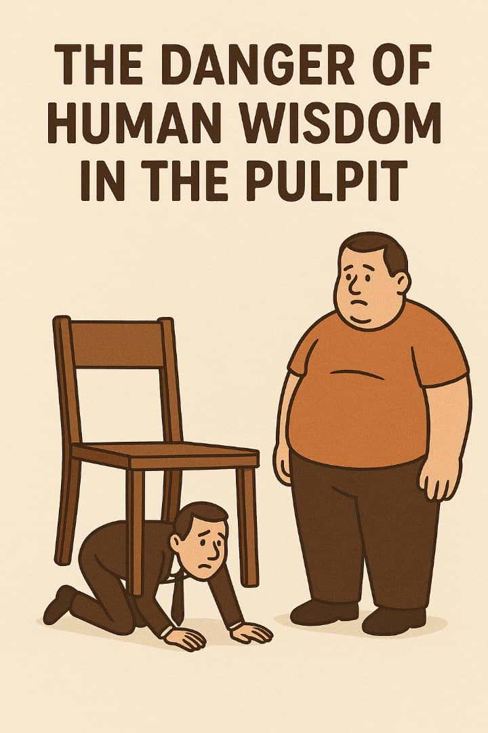
THE DANGER OF
Human's Wisdom In the Pulpit
(A CALL BACK
TO GOD'S VOICE)

Slide 2
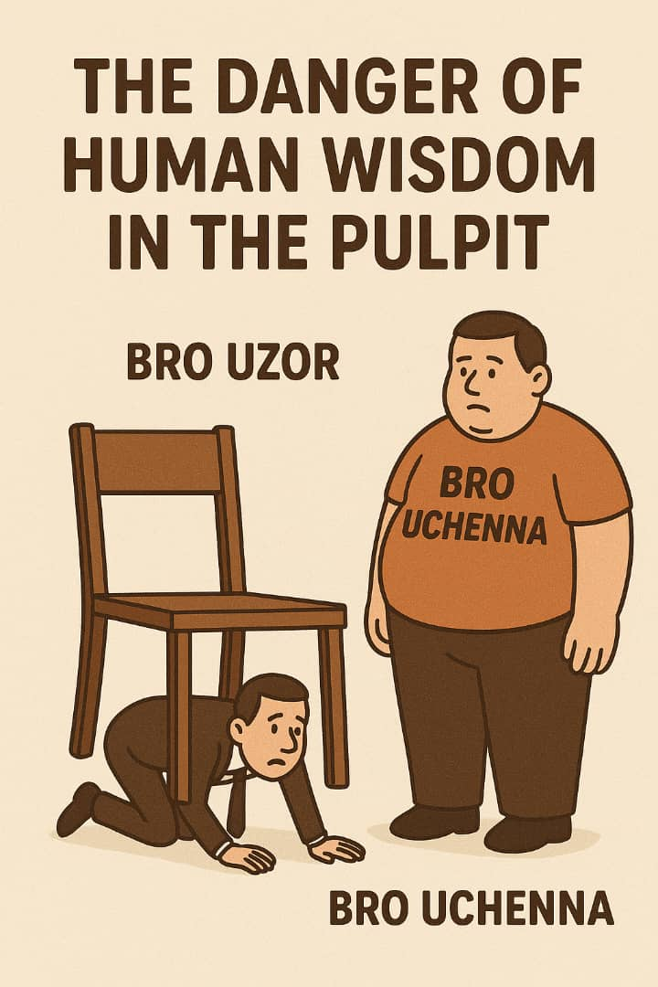

Slide 3
THE DANGER OF
Human's Wisdom
In The Pulpit
(A CALL BACK TO GOD’S VOICE )
TEXT: Matthew 16:13 -18, Luke 1: 5 - 24, Acts 5:1-11, Matthew 19:26,
2 Corinthians 5 : 7.
NOTE: Every believer has a pulpit consciously or unconsciously

Slide 4
A. Introduction : The Sacredness of the Pulpit
The pulpit is not a stage for performance—it is a place for divine utterance.
The pulpit is where heaven speaks, not where man impresses. 1 Corinthians 2:4-5.
The tragedy of our generation is that many pulpits have become platforms for human intellect instead of sanctuaries for divine encounter.

Slide 5
B. What is Human Wisdom?
Human wisdom is knowledge that originates from intellect, education, experience, and reasoning.
It is not inherently evil, but becomes dangerous when it replaces or overshadows the wisdom of God. James 3:15 – 17.
Sermon note: The pulpit is not for showcasing oratory, philosophy, or psychology—it is for declaring “Thus saith the Lord.”

Slide 6
C. The Dangers of Human Wisdom on the Pulpit
It Exalts Man and Silences God
It makes the preacher the center instead of Christ.
It entertains the mind but starves the spirit.
2. It Lacks Transforming Power
Human wisdom may move emotions, but only God's Word transforms lives. Hebrews 4:12

Slide 7
3. It Produces Empty Churches
People hear nice speeches, but go home unchanged.
It breeds shallow Christianity, where people know about God but don’t know Him.

Slide 8
D. What Should Be on the Pulpit?
God’s Pure Word
Preach the Bible, not ideas. 2 Timothy 4:2
2. The Fear of God
The pulpit must carry a holy reverence, not pride.
The preacher is a voice, not a celebrity.
3. The Holy Spirit’s Leadership
He alone knows what the people truly need. John 16:13.

Slide 9
4. The pulpit must burn with the fire of
heaven—not echo the wisdom of men.
E. Conclusion: Let God Speak Again
May every preacher cry like Moses in Exodus 33:15 – Isaiah 28:8 Lord, silence every voice that is not Yours. Tear down every pulpit that exalts flesh. Raise up messengers again—not motivational speakers—but men and women who tremble at Your Word.

