Slide 1
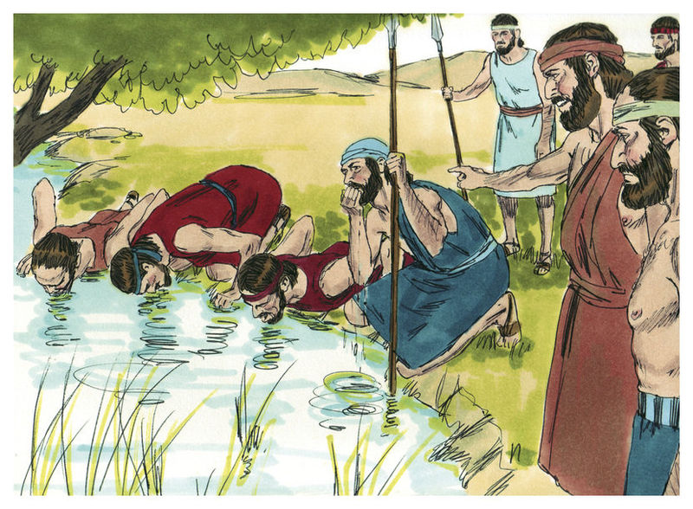
THE WATER TEST

Slide 2
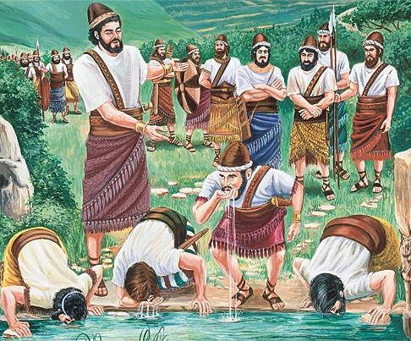
THE WATER TEST

Slide 3
Meditate
Romans 15:4,
1 Corinthians 10:6,
2 Timothy 3:15-17

Slide 4
FOUR CHARACTERS IN OUR STORY
GIDEON - The Lord Jesus Christ
THE 22,000 - Those who stopped or are not following Christ
THE 9700 - The called many
THE 300 - The chosen few

Slide 5
Scriptural reference:
Judges 7:1-15

Slide 6
2. OUR PURPOSE
- 1 Peter 1:5,
- Matthew 6:19-21,
- Titus 1:2

Slide 7
Scriptures to further meditate on
- Deuteronomy 8:1-20,
- Deuteronomy 32:15, - Hosea 13:6

