Slide 1
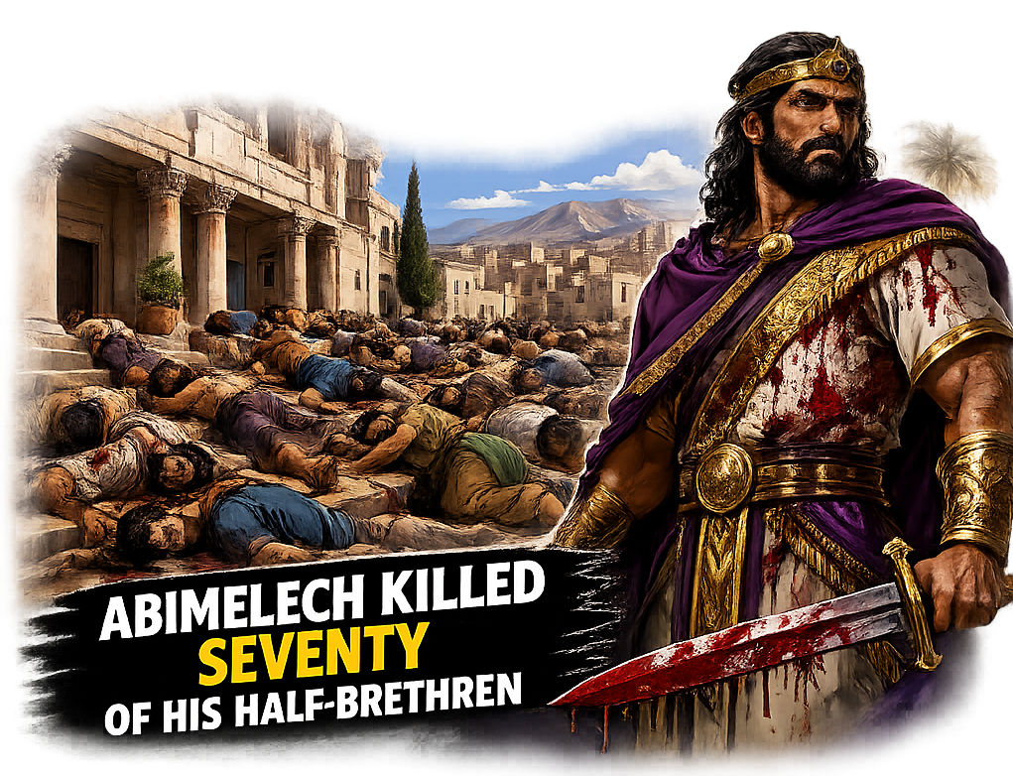
the
men
of
SHECHEM
Text:
Judges 9

Slide 2
A. INTRODUCTION
The story of Abimelech in Judges 9 is a sobering warning for us today.
After Gideon’s death, Abimelech exalted himself, made himself king, and destroyed his own brethren. His life teaches the danger of self-exaltation, the importance of divine calling, and the tragic end of ambition without God.

Slide 3
B. THE CHARACTERISTICS OF GIDEON
G – God-chosen in weakness (Judges 6:15)
Sermon note:
God does not call the qualified; He qualifies the called. (1 Corinthians 1:27)

Slide 4
B. THE CHARACTERISTICS OF GIDEON
I – Intercessor with a burden for his people (Judges 6:13)
Sermon note:
A true servant carries the burden of the people, not selfish ambition (Romans 9:2–3).

Slide 5
B. THE CHARACTERISTICS OF GIDEON
D – Defender of true worship - destroyer of Baal altar (Judges 6:25–26)
Sermon note:
He upheld the ancient landmark. (Proverbs 22:28)

Slide 6
B. THE CHARACTERISTICS OF GIDEON
E – Enquirer of God’s will (Judges 6:17)
Sermon note:
Many today run without being sent, preach without hearing, and fight battles God never assigned.

Slide 7
B. THE CHARACTERISTICS OF GIDEON
O – Obedient to divine instruction in battle (Judges 7:7)

Slide 8
B. THE CHARACTERISTICS OF GIDEON
N – Not self-seeking but God-dependent
Sermon note:
He rejected kingship, giving all glory to God (Judges 8:23).

Slide 9
C. THE CHARACTERISTICS OF ABIMELECH
A – Ambitious for power - self-exaltation (Judges 9:6; Luke 14:11; Philippians 2:9).

Slide 10
C. THE CHARACTERISTICS OF ABIMELECH
B – Betrayer of his father’s legacy
(Judges 9:18)
Sermon note:
A generation that forgets the fathers repeats error.

Slide 11
C. THE CHARACTERISTICS OF ABIMELECH
I – Illegitimate authority (self-crowned)
Sermon note:
He took what God did not give (Hebrews 5:4).

Slide 12
C. THE CHARACTERISTICS OF ABIMELECH
M – Murderous in pursuit of power
Sermon note:
He killed seventy brothers to secure position.

Slide 13
C. THE CHARACTERISTICS OF ABIMELECH
E – Empty of divine calling

Slide 14
C. THE CHARACTERISTICS OF ABIMELECH
L – Lover of control and dominance

Slide 15
C. THE CHARACTERISTICS OF ABIMELECH
E – Established by men, not God His throne was built on human support, not divine approval.

Slide 16
C. THE CHARACTERISTICS OF ABIMELECH
C – Carnal leadership
Sermon note:
What begins in the flesh cannot be sustained by the Spirit.

Slide 17
C. THE CHARACTERISTICS OF ABIMELECH
H – Hopeless end
Sermon note:
His life ended in disgrace, proving that ungodly ambition leads to destruction.

Slide 18
D. WHO ARE THE MEN OF SHECHEM?
(Judges 9:6)
They supported Abimelech after he killed his brothers. They represent those who reject truth and embrace error. (Acts 7:52)
They are:
Lovers of the world more than the Word of God.
Lovers of their churches more than Christ.
Lovers of pastors more than Jesus.
Lovers of friends more than the truth.

Slide 19
E. WHO IS JOTHAM?
(Judges 9:7-20)
Jotham represents:
A hidden but true disciple
A voice like Micaiah in this generation
A true apostolic voice
A genuine servant of God
A Spirit-filled believer
A bold Christian
A representation of true ministers in our time

Slide 20
F. CONCLUSION
Judges 9 reveals the battle between truth and error, between divine calling and human ambition, between Christ and false systems.
(1 Peter 1:18–19; Hebrews 11:35–38; 2 Corinthians 12:7–10).

Slide 21
SHALOM!!!

