Slide 1
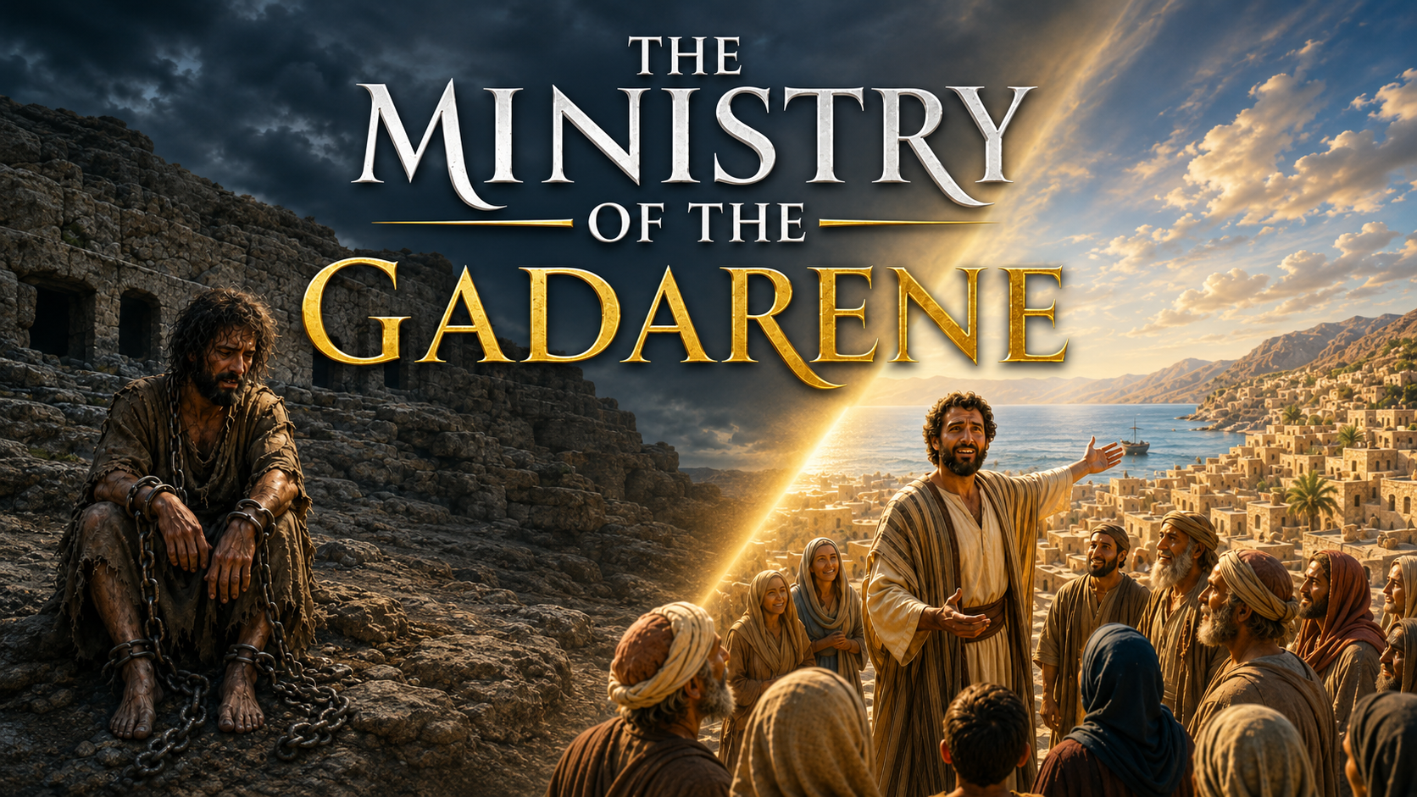
Main Text: Mark 5:1–20; Luke 8:26–39
Additional Text: Matt. 7:21-23

Slide 2
Point 1:
TWO DIFFERENT KINDS OF MINISTRIES
We are looking at two different kinds of ministries in the Church today:
The ministry of reconciliation — 2 Cor. 5:18–21
The ministry of the Gadarene — Mark 5:19–20

Slide 3
Point 2:
THE MINISTRY OF RECONCILIATION
The work of the ministry of reconciliation is depicted in the story of the Good Samaritan. Luke 10:30–35
Reconciliation was the purpose for which Jesus died. 2 Cor. 5:18.
The ministry of Christ through the Holy Ghost today is the ministry of reconciliation. 2 Corinthians 5:18–21.
The Holy Ghost is using the fivefold ministry to do this work of reconciliation. Ephesians 4:11–15.

Slide 4
Reconciliation comes through the knowledge of His Word —“the Word of reconciliation” 2 Corinthians 5:19.
“Teach all nations” - Matthew 28:19.
“Teaching us that…” - Titus 2:11–12.
“Thy Word is truth” - John 17:17.
Reconciliation is by the revelation of His Word.
“The just shall live by faith” — Heb. 11:6.
Therefore, the fivefold ministry is seen working together to perfect the Church, not in isolation.

Slide 5
Point 3:
THE MINISTRY OF THE GADARENE
Texts: Mark 5:1–20; Luke 8:26–39
The ministry of the Gadarene is not a ministry for reconciliation, although it was commissioned by God. — Mark 5:19–20
The ministry of the Gadarene is a ministry raised to witness the power or reality of God in a specific area, for example, healing, deliverance, and miracles — Psalm 68:18.
The Gadarene did not know anything about the Word of reconciliation. — 2 Corinthians 5:19.

Slide 6
The ministry of the Gadarene is an extension of God’s mercy, not for the salvation of men, but for the temporal needs of man—prosperity, healing, deliverance, fruit of the womb, etc.
His ministry made the Lord Jesus popular — Luke 8:39; Mark 5:20.
Jesus refused him from walking with Him and being with Him. Mark 5:18–19

Slide 7
CONCLUSION
The ministry of the Gadarene is not for salvation. Both the minister and his followers are void of the “Word of reconciliation”; therefore, they cannot be reconciled with God.
They are used by God and sent by God, but they have no part in His Kingdom.
Don’t be a Gadarene minister. Don’t follow a Gadarene minister.

Slide 8
SHALOM!!!

