Slide 1
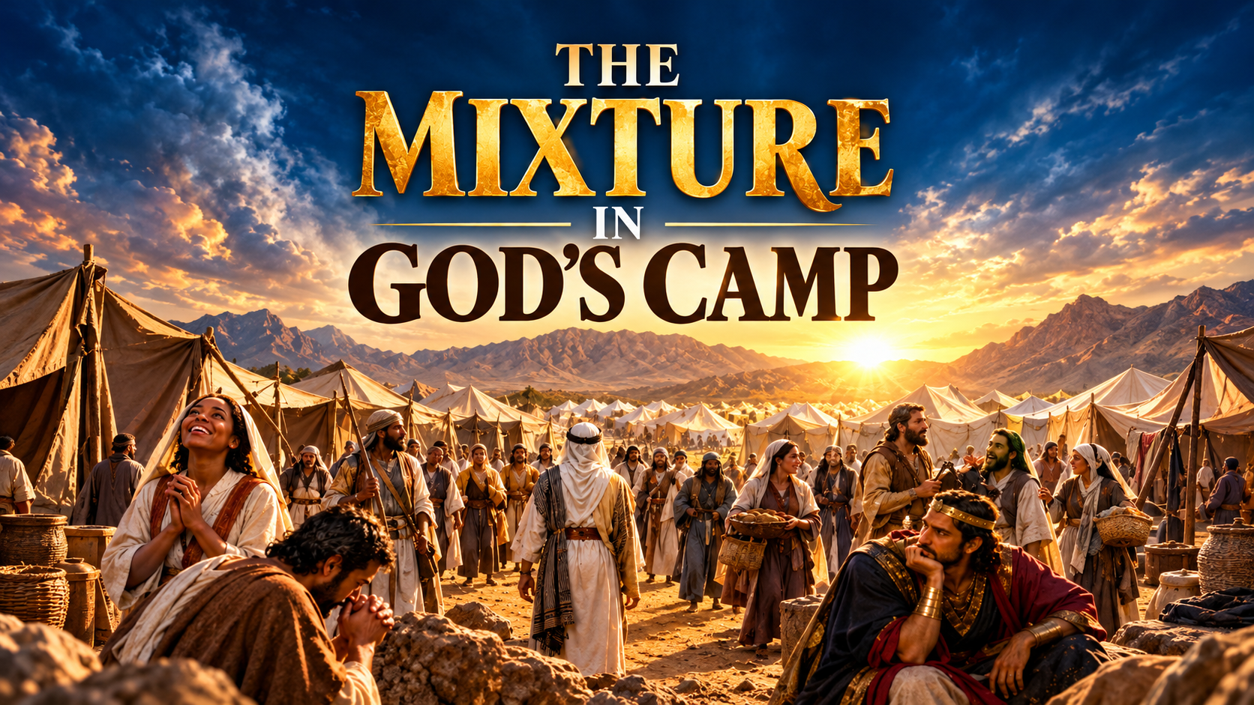

Slide 2
INTRODUCTION
Scriptural References: Exo. 12:38; Num. 11:4; Neh. 13:3; Rom. 15:4
The Church is God’s camp.
Just as Israel was God's camp in the Old Testament, so is the Church God's camp in this present dispensation. As it was in the camp of Israel, so it is in the Church today.
The Bible reveals that a mixed multitude came out of Egypt with the children of Israel (Exodus 12:38). This mixture later became a source of lusting, murmuring, and trouble among God's people (Numbers 11:4).

Slide 3
Likewise, the visible Church of Jesus Christ is a camp filled with different kinds of people, not all of whom have the same spiritual identity, motives, or relationship with God.

Slide 4
THE FOUR KINDS OF PEOPLE IN THE CHURCH
1. The True Children Of God
Scriptural References: Matt. 13:24–30, 36–43; John 10:27–28; Matt. 13:3–8, 18–23; 1 Pet. 1:9
Their Biblical Descriptions:
The Good Seed (Matt. 13:38); The Wheat (Matt. 13:24–30); The Sheep of Christ (Jn. 10:27–28); The Good Ground Believers (Matt. 13:23); The Children of the Kingdom (Matt. 13:38)
These are the genuine children of God, the saints of God for whom Christ gave His life. They are those whose names are written in the Lamb's Book of Life (Revelation 13:8; 17:8).

Slide 5
Characteristics of the True Children of God
They are sincere and genuine in their walk with God.
They love, receive, and obey the truth (John 8:47).
They receive the baptism of the Holy Ghost.
They do not take pleasure in sin or make a practice of living in sin. (1 Jn. 3:9).
They have a genuine Father-child relationship with God (Rom. 8:14–16).

Slide 6
Characteristics of the True Children of God
They are heavenly-minded (Colossians 3:1–2).
They come to Christ primarily for the salvation of their souls (1 Peter 1:9).
They bear the fruits of righteousness and godliness (John 15:5).
They love the brethren and seek the peace and unity of the Church (1 John 3:14).
They endure trials and remain faithful to Christ.

Slide 7
THE FOUR KINDS OF PEOPLE IN THE CHURCH
2. The Children Of Satan
Scriptural References: Matt. 13:24–30, 37–39; Jn 8:39–44; 1 Jn. 4:6
Their Biblical Descriptions: (THE TARES)
Jesus identified the tares as the children of the wicked one (Matthew 13:38).
They are planted by the enemy among the wheat.

Slide 8
Their Purpose And Activities
To choke, hinder, and frustrate the growth of the wheat.
To turn a beautiful and productive farm into an uncultivated bush.
To hinder the spiritual progress of the Church.
To destroy the harmony, peace, and unity of God's people.
To introduce corruption, compromise, and ungodliness into the assembly.

Slide 9
Characteristics of the Children of Satan
They hate the truth and reject sound apostolic doctrine (John 8:39–44; 1 John 4:6).
They seek positions, influence, and power in order to control others (3 John 1: 9–10).
They continually work against the harmony and peace of the Church.
They practise sin and influence others to do likewise, either secretly or openly.

Slide 10
Characteristics of the Children of Satan
They are spiritual fire-extinguishers, seeking to quench genuine spiritual fervour in the Church.
They may appear religious outwardly while resisting the truth inwardly.
They promote division, strife, bitterness, and rebellion.

Slide 11
THE FOUR KINDS OF PEOPLE IN THE CHURCH
3. The Birds of the Trees
Scriptural References: Matt. 13:31–32; John 6:24–26; Mark 5:1–20
Their Description: (THE BREAD SEEKERS)
These are people who seek Jesus primarily for what they can receive from Him rather than for the salvation of their souls. They are interested in the benefits of Christ without necessarily being interested in a genuine relationship with Him.
They may be described in this teaching as the Gadarene-type ministers, drawing an illustration from Mark 5:1–20.

Slide 12
Characteristics of the Birds of the Trees
They follow Christ primarily for earthly and temporal benefits such as healing, deliverance, protection, provision, and prosperity.
They have little interest in the deeper mysteries of salvation, except for exhortations that strengthen their faith for earthly benefits.
They are not heavenly-minded, although they may be moral, religious, and prayerful.

Slide 13
Characteristics of the Birds of the Trees
They cannot produce the genuine fruits of Christ without regeneration, although they may outwardly display Christian qualities through self-righteousness.
They draw temporal benefits from Christ and receive blessings through His power.
They may experience the anointing or manifestations of spiritual power without receiving the baptism of the Holy Ghost.

Slide 14
Characteristics of the Birds of the Trees
They handle spiritual things with earthly achievements in view, such as fame, money, prestige, recognition, and honour.
They cannot fully submit to the Word of God because elements of compromise remain in their lives.
They love earthbound sermons that sound highly motivational, intellectual, and inspiring but place little emphasis on repentance, holiness, and salvation.
Their commitment to Christ is often dependent on the earthly benefits they receive.

Slide 15
THE FOUR KINDS OF PEOPLE IN THE CHURCH
4. The Hirelings
Scriptural References: John 10:11–13; Matthew 17:24–27
Their Description: (THE BORROWED VESSELS)
These are individuals who may be used as instruments to accomplish certain purposes without necessarily having a genuine personal relationship with God.

Slide 16
They may be gifted, talented, or useful in the work of the Church without being spiritually regenerated.
They may possess gifts or unusual abilities from birth.
They may manifest gifts even when they have little interest in serving God.
They may function as employees or workers in the Church, rendering useful services without genuine spiritual commitment.
They may serve as instruments through which particular purposes are accomplished.

Slide 17
Characteristics of the Hirelings
They have no genuine personal relationship with God.
They simply exercise their gifts, perform their duties, and go their way.
They may be morally upright or immoral.
They attach little or no value to spiritual things.

Slide 18
Characteristics of the Hirelings
They are not genuinely interested in prayer, fellowship, spiritual growth, or other spiritual exercises.
Their involvement in the Church may be motivated primarily by employment, personal advantage, or obligation.
They may be useful in the work of God without being personally committed to the God of the work.
They do not necessarily possess the heart of a true shepherd who genuinely cares for the sheep (Jn. 10:12–13).

Slide 19
CONCLUSION
The visible Church contains different kinds of people with different motives, interests, spiritual conditions, and relationships with God.

Slide 20
In this teaching, they have been considered under four categories:
The True Children of God — The wheat, the good seed, and the sheep of Christ.
The Children of Satan — The tares planted by the wicked one.
The Birds of the Trees — Those who seek Christ primarily for earthly benefits.
The Hirelings — Those who may be useful in religious service without genuine spiritual commitment.

Slide 21
The great question is:
WHAT CATEGORY DO YOU BELONG TO?
It is not enough to be found in the Church; the important thing is to belong to Christ.
It is not enough to be religious, gifted, prayerful, influential, or useful in the house of God. We must be genuinely born again and belong to the Lord.
Additional Scripture: 2 Peter 2:10

Slide 22
SHALOM!!!

