Slide 1
THE
STAGE
OF PERFECTION

Slide 2
AIMS OF THE STUDY
To help believers understand that the Bride Assembly Church is not a denomination, but a restored church
To help believers understand where the Church presently stands in God’s restoration work.
To help believers see the necessity of perfection in the Christian life.

Slide 3
To encourage believers to make their calling and election sure.
To awaken in believers the consciousness of the soon coming of the Lord and the reality of home-going.

Slide 4
INTRODUCTION
God’s expectation for the Church is nothing short of perfection. Everything the Church needs to fulfill the purpose for which it was established has already been provided by God (Eph. 4:11–13).
The early Church of Christ truly lived up to God’s expectation when it was first established, as seen in book of Acts. However, with time, a great corruption set in.

Slide 5
THE PERVERSION
The gospel of salvation committed to the apostles became distorted and perverted after the death of the apostles. Various strange doctrines and teachings inspired by the devil were introduced into the faith. This eventually produced another version of Christianity completely different from the original apostolic faith. Nevertheless, the purpose of God cannot be defeated.
Scriptural References
Matt. 13:33; 1 Tim. 4:1–3; 2 Pet. 2:1–3; 2 Cor. 11:4, 13.-14

Slide 6
RESTORATION
At midnight, when the light of the gospel had completely disappeared (Matt. 25:6), God began a work of restoration according to the parables in Matt. 13:44–48.
This restoration is clearly represented in the growth of the corn plant in Mark 4:26–28:
The blade — Justification restored
The ear — Sanctification restored
The full corn in the ear — Restoration of the gifts

Slide 7
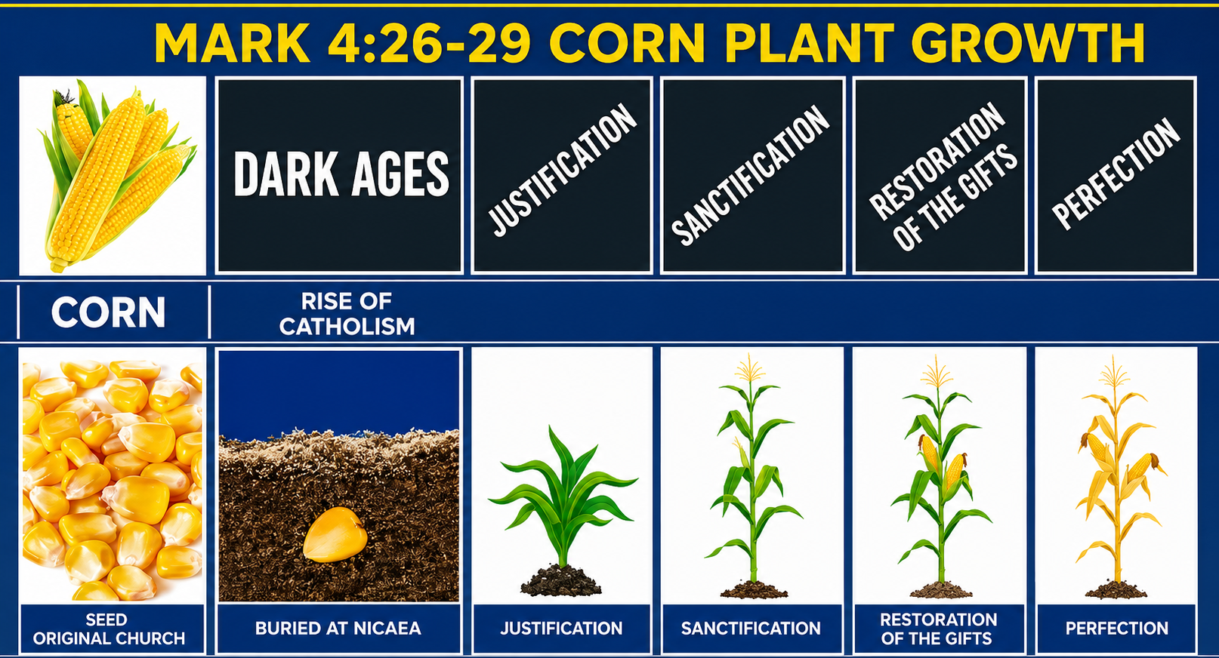

Slide 8
THE STAGE OF PERFECTION
We are now at the stage where the Church is being perfected because the fruit of the seed is being brought forth, signifying that the harvest (rapture) is near (Mark 4:29).
Today, we see a group of believers whose practice in doctrines, power, and Christian conduct closely resemble the Church in the Book of Acts.

Slide 9
THE STATURE OF THE PERFECT MAN
(Eph. 4:13; Rom. 8:29)
As the Church is being perfected, individual believers who are part of this restoration work must grow into the stature of the perfect man according to 2 Peter 1:5–7

Slide 10
Steps to Reach the Stature of the Perfect Man
(2 Peter 1:5–7)
Add to your faith:
Virtue — Moral excellence (Phil. 4:8)
Knowledge — Understanding of truth (Hos. 4:6)
Temperance — Self-control (Prov. 16:32)
Patience — Endurance and steadfastness
(James 1:3–4)

Slide 11
Godliness — Reverence and holy living (1 Tim. 4:8)
Brotherly Kindness — Love toward fellow believers (Heb. 13:1, Gal 6:10)
Charity — Divine love toward all men (1 Cor. 13:13)

Slide 12
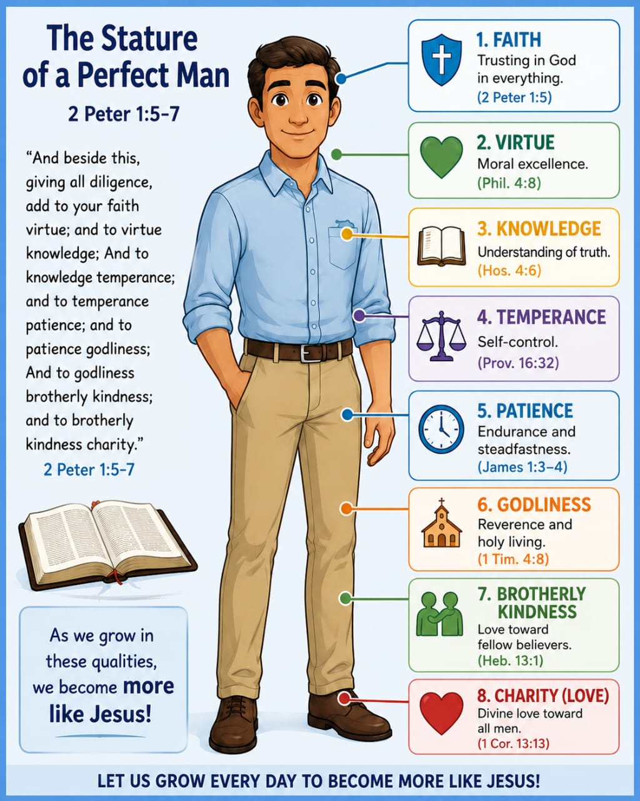

Slide 13
EVIDENCE OF BEING IN THE MESSAGE
The evidence that a person is truly in the Message is not merely being a member of an end-time message church, knowing the mysteries of the Message, manifesting gifts or graces, or bearing a scriptural title.

Slide 14
The true evidence is allowing the purpose of the Message to be fulfilled in one’s life. The Message is meant to call us out of unbelief, error, and idolatry, restore us back to the apostolic faith, and prepare the Bride for the coming of the Lord.
Scriptural References
2 Cor. 6:14–17; Rev. 19:7.

Slide 15
CONCLUSION
If the Firstborn is perfect, then the other brethren must also grow into perfection.
Matthew 5:48:
“Be ye therefore perfect, even as your Father which is in heaven is perfect.”

Slide 16
SHALOM!!!

