Slide 1
TREASURES
of this
REVIVAL
Vol. 2

Slide 2
INTRODUCTION
James 5:7 - This present revival is the latter rain revival.
Matt. 13:52

Slide 3
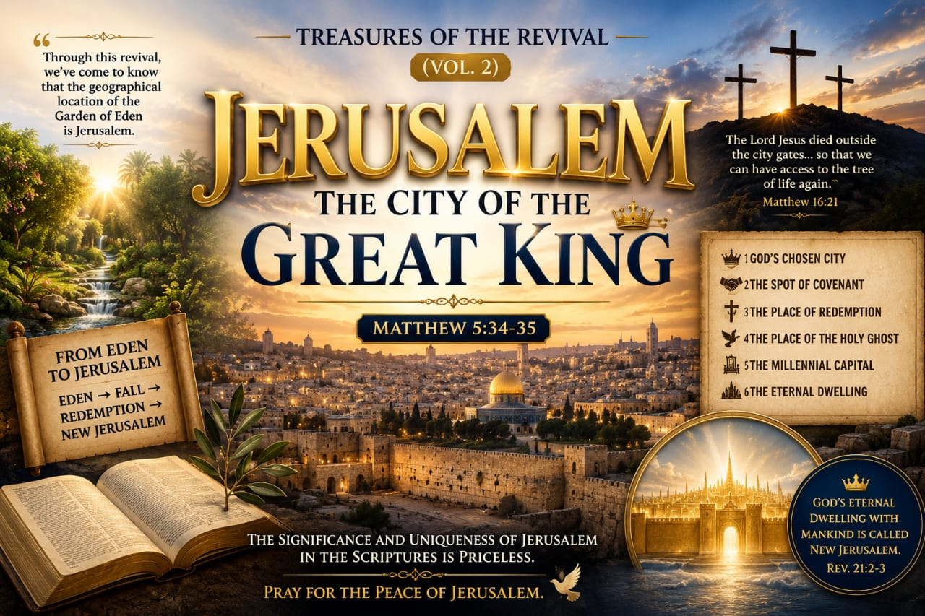

Slide 4
Jerusalem is the most significant city in Scripture. From Genesis to Revelations, it occupies a unique place in God's redemptive plan.
Through this revival, we've come to know that the geographical location of the Garden of Eden is Jerusalem.

Slide 5
God's presence in the beginning with mankind was called the Garden of Eden.
The Garden of Eden was not a vegetative garden; it was God's sanctuary with man. (Gen. 3:8).

Slide 6
OTHER THINGS TO NOTE ABOUT JERUSALEM
1. It is God’s chosen city.
Scriptures: Deut. 12:5, 11; 1 Kings 11:13, 36; 2 Chron. 6:6
The only city God chose to place His name.
That's why the temple was built there.
It is the city of the Great King.
Scriptures: Psa. 48:2; Psa. 48:14; Psalm 87:3; Gen. 14:18–20

Slide 7
OTHER THINGS TO NOTE ABOUT JERUSALEM
2. Adam "to dress and keep it" means to serve and guard. In Hebrew, the same words are used to describe the priestly ministry in the tabernacle.
It spoke of the priestly ministry of Adam.
When man fell, God drove man from the Garden. (Gen. 3:24).

Slide 8
But after the redemption, man is now placed in New Jerusalem. (Rev. 3:12)
Eden → Fall → Redemption → New Jerusalem.
From Eden to Jerusalem.

Slide 9
OTHER THINGS TO NOTE ABOUT JERUSALEM
3. It was the spot where God told Abraham to sacrifice Isaac, and where He made the everlasting covenant with him by swearing.
Scriptures: Gen. 22:1–2, 14–18.
The exact spot (Mount Moriah) where the temple was built.

Slide 10
OTHER THINGS TO NOTE ABOUT JERUSALEM
4. The Lord Jesus died outside the city gates of Jerusalem, taking the flaming sword of the cherubim, so that we can have access to the tree of life again.
Scriptures: Matt. 16:21; Luke 13:33; Luke 18:31

Slide 11
OTHER THINGS TO NOTE ABOUT JERUSALEM
5. The Holy Ghost first descended in Jerusalem.
Men first received eternal life there.
Scriptures: Luke 24:49; Acts 1:4
Telling us that the exact spot of the tree of life is where men received eternal life.

Slide 12
OTHER THINGS TO NOTE ABOUT JERUSALEM
6. It will be the capital of the millennial kingdom.
Scriptures: Isaiah 2:2–4; Micah 4:1–3

Slide 13
OTHER THINGS TO NOTE ABOUT JERUSALEM
7. God's eternal dwelling with mankind is called New Jerusalem.
Scriptures: Rev. 21:2–3

Slide 14
CONCLUSION
Scriptures: Deut. 11:10–12; Psalm 106:24; Zech. 7:14; Dan. 8:9
The significance and uniqueness of Jerusalem in the Scriptures helps us to know that it was where God started with man (Eden) and where He will end with man (the millennial capital).
Jerusalem is the geographical location of Eden.
Pray for the peace of Jerusalem.

Slide 15
SHALOM!!!

