Slide 1
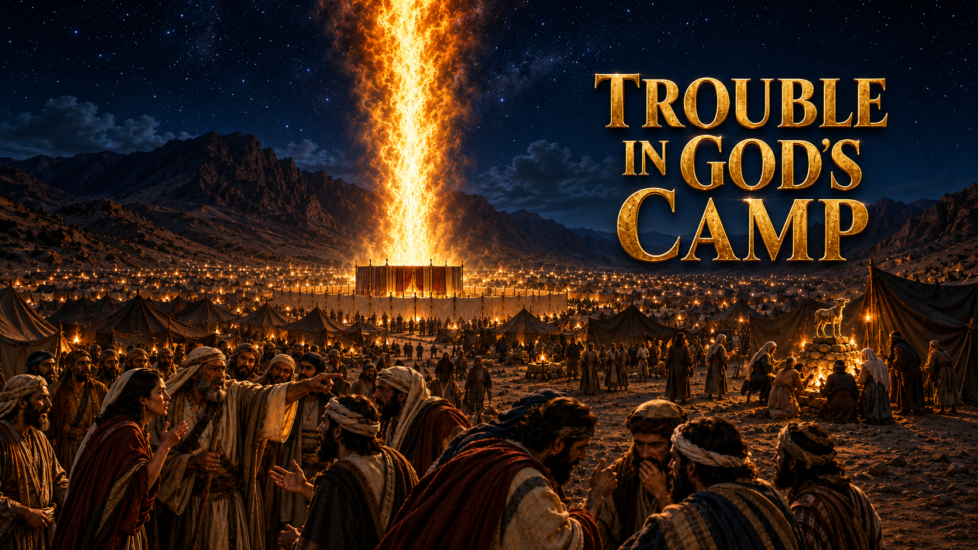
Main Text:
Rom. 15:4; Deut. 23:14; 1 Tim. 3:15; 1 Pet. 2:5

Slide 2
INTRODUCTION
God’s camp, from ages past, has always had certain internal troubles, despite the true presence of God among His people.
The Church is God’s camp.
(1 Cor. 12:13; 1 Tim. 3:15; 1 Pet. 2:5; Heb. 12:22–24)
We will look at several stories in the Bible that showcase the presence of trouble among God’s people.

Slide 3
Story 1:
THE GAINSAYING OF KORAH
Numbers 16; Jude 11
Korah, Dathan, and Abiram rose against Moses and Aaron and challenged the order God had established in the camp.

Slide 4
The troubles manifested:
Carnal ambition.
Failure to submit to God’s order.
Politics in the Church.
Rebellion against God-appointed leadership.
Envy and the desire for position.
Similar Scriptures:
Numbers 12:1–10; Psalm 106:16–18; 1 Sam. 15:23; 1 Corinthians 3:3; Hebrews 13:17

Slide 5
Story 2:
THE FEAST OF BAAL-PEOR
Numbers 25:1–9; 1 Corinthians 10:6–8
Israel joined itself to Baal-peor through the influence of the daughters of Moab. This brought corruption and judgment into God’s camp.

Slide 6
The troubles manifested:
Fornication.
Lasciviousness.
Idolatry.
Ungodly associations.
Compromise with the world.
Similar Scriptures:
Numbers 31:16; Psalm 106:28–31; Revelation 2:14; 1 Corinthians 6:15–20; James 4:4

Slide 7
Story 3:
REMEMBERING EGYPT
Numbers 11:4–6
The people lusted after the things they had enjoyed in Egypt. They remembered Egypt and despised God’s provision.

Slide 8
The troubles manifested:
Lusting.
Remembering Egypt.
Despising God’s provision.
Dissatisfaction with what God had provided.
Longing for the life from which God had delivered them.
Similar Scriptures:
Exodus 16:2–3; Numbers 14:1–4; Psalm 78:17–22; Acts 7:39; Hebrews 3:12–13

Slide 9
LESSONS TO LEARN ABOUT GOD’S CAMP
1. God’s camp is not filled with perfect people:
Texts: Rom. 15:1–3; Rom. 5:6–8
God’s camp contains people who are still growing, learning, and being perfected. Therefore, there will sometimes be carnal manifestations among God’s people.
Similar Scriptures:
1 Corinthians 3:1–3; Galatians 6:1–2; Eph. 4:11–13; Philippians 3:12–15; James 3:2

Slide 10
LESSONS TO LEARN ABOUT GOD’S CAMP
2. The camp of God contains mixed multitudes:
Texts: 2 Timothy 2:19–21; Matthew 13:24–30
Not everyone found among God’s people has the same nature, motives, or spiritual condition. There may be sincere believers, carnal believers, hypocrites, and unbelievers within the visible congregation.
Similar Scriptures:
Exodus 12:38; Numbers 11:4; Matthew 13:47–50; 1 Corinthians 10:1–5; 1 John 2:19

Slide 11
LESSONS TO LEARN ABOUT GOD’S CAMP
God judges sin among His people:
Texts: 1 Corinthians 11:27–32; Acts 5:1–11
The presence of God in the camp does not mean that God overlooks sin. God disciplines and judges wrongdoing among His people to preserve the purity of His camp.
Similar Scriptures:
Deuteronomy 23:14; Joshua 7:1–26; Hebrews 12:5–11; 1 Peter 4:17; Revelation 2:20–23

Slide 12
LESSONS TO LEARN ABOUT GOD’S CAMP
4. Satan looks for a loophole through which to devour:
Texts: 1 Peter 5:8; 2 Corinthians 2:11
Satan looks for an opportunity to enter, corrupt, divide, and destroy. Unforgiveness, bitterness, pride, lust, rebellion, and carelessness can give him an advantage within God’s camp.
Similar Scriptures:
Ephesians 4:26–27; Luke 22:31–32; John 13:2, 27; Ephesians 6:11; James 4:7

Slide 13
LESSONS TO LEARN ABOUT GOD’S CAMP
5. Every carnality outside the camp can be seen in God’s camp if we give the flesh a chance
Texts: Galatians 5:16
Being in God’s camp does not automatically destroy the works of the flesh. If believers give the flesh an opportunity, the same sins found in the world can manifest among God’s people.
Similar Scriptures:
Galatians 5:19–21; Romans 8:12–13; 1 Corinthians 5:1–2; Colossians 3:5–10; 1 Peter 2:11
6. To make manifest those who are approved
Text: 1 Cor. 11:19

Slide 14
CONCLUSION
Trouble in God’s camp does not mean that God is absent or that His Word has failed. It reveals the imperfections of God’s people, the presence of mixed multitudes, the activities of the tempter, and the consequences of giving the flesh an opportunity.

Slide 15
However, God does not abandon His camp because of its troubles. He exposes sin, judges rebellion, corrects His people, and calls the camp back to holiness.
“For the LORD thy God walketh in the
midst of thy camp, to deliver thee, and
to give up thine enemies before thee;
therefore shall thy camp be holy.”
- Deuteronomy 23:14

Slide 16
SHALOM!!!

