Slide 1
WHAT
IS
RIGHTEOUSNESS?
Matthew 7:21- 23, Col1:19,
Col 1:15 Romans 8:29, 1 Corinthians 15:49, Eph 4:22-24

Slide 2
Points to consider
A. Introduction
It is very unfortunate that the word “righteousness” has been misunderstood, misinterpreted, degraded, bastardized and misrepresented. In this age, we find it difficult to really differentiate God's own righteousness from self righteousness. Furthermore, the yardstick men use to measure or attain God's righteousness has also been distorted.

Slide 3
Some Christians believe that they are righteous because
1. They are morally good.
2. They operate the gifts of the spirit.
3. They are born into a Christian home.
4. They are church workers and goers.
5. They possessed so much wealth.
6. They have higher titles than others.
7. They are pastors, prophets, evangelist teachers to mention but a few.

Slide 4
B. WHAT IS RIGHTEOUSNESS?
This simply means to believe the totality of God's word.
Genesis 15:1-6, Galatians 3:6.
NOTE: Holiness is a part of righteousness.
Romans 6:19.

Slide 5
C. WHO IS RIGHTEOUS?
Isaiah 64: 6, Phil 3:9, Romans 10:3, Luke 18:9-14, Ephesians 2:8-9
A righteous man or woman possesses the character of the word RIGHTEOUS. Which means, who is righteous is seen from the word RIGHTEOUS alphabetically. The word RIGHTEOUS has dynamic meaning alphabetically.

Slide 6
R - RIGHT STAND WITH GOD
Proverbs 21:3, Job 1: 1-12.
NOTE: Right stand with God makes a man's will or wish die.
I - INTIMATE OR INWARD FELLOWSHIP OR RELATIONSHIP WITH GOD.
Eph 5: 22-27, John 15: 4-5, Phil 3:10.
NOTE: Your intimacy is your acceptance of marriage with Christ.

Slide 7
G - GOVERNMENT
Psalm 22:28, Daniel 4:34-37, Matthew 28:18, Matthew 26:39
NOTE: A righteous man is guided and ruled by God's government.
H - HOLINESS
1 Peter 1: 15-16, Heb12:14, Romans 12:1.
NOTE: True holiness is approved and proven by God's standard not men’s standard.

Slide 8
T – TOTALITY OF GOD’s WORD
Isaiah 40:8, Psalm 119:160, Hebrews 4:12.
NOTE: A righteous man believes the totality of God's word.
E - ETHICS
Psalm 119:9
NOTE: He believes and stands on God's rules and regulations.

Slide 9
O- OUTWARD APPEARANCE.
Mathew 7:15-20, Matthew 23:25-3.
NOTE: A tree is known by her fruit.
U - UNDERSTANDING CHRIST.
Hosea 4:6 Matthew 16:13- 18.
NOTE: A true wife knows and understands her husband.
S – STABILITY: Ruth 1:16, Esther 4:16, Psalm 16:18
NOTE: Stability is her watch word. She is not righteous today and unrighteous tomorrow.

Slide 10
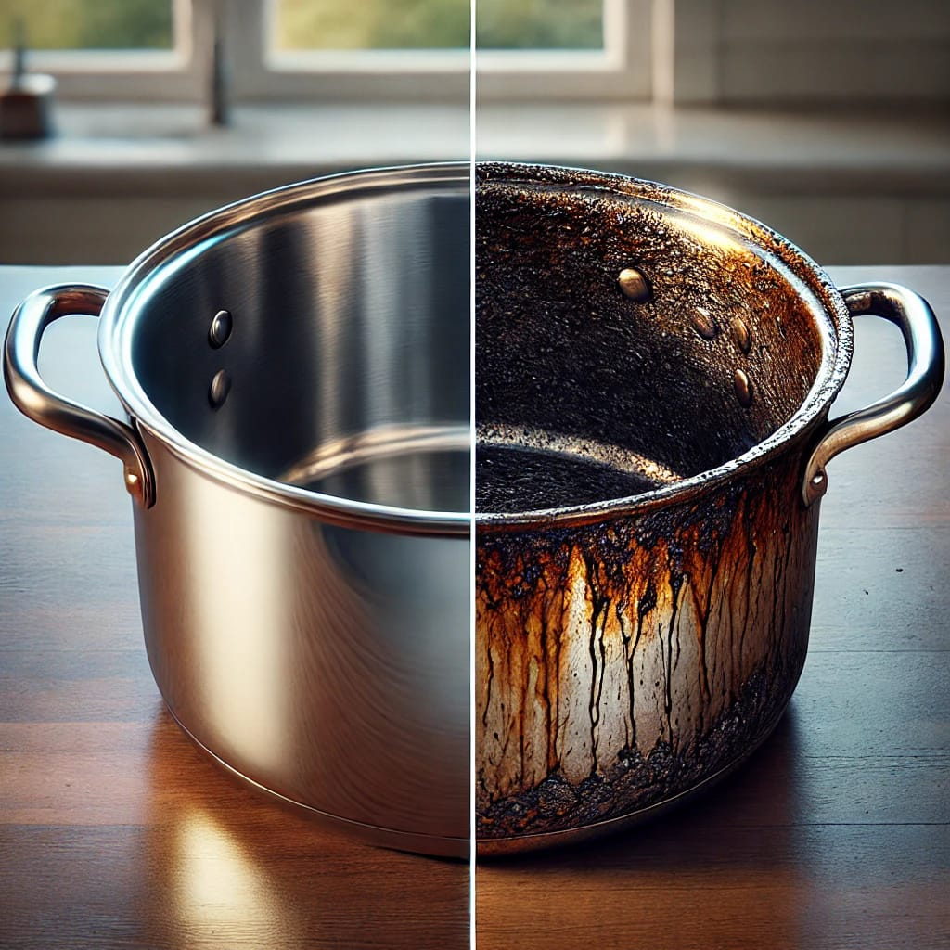

Slide 11


Slide 12
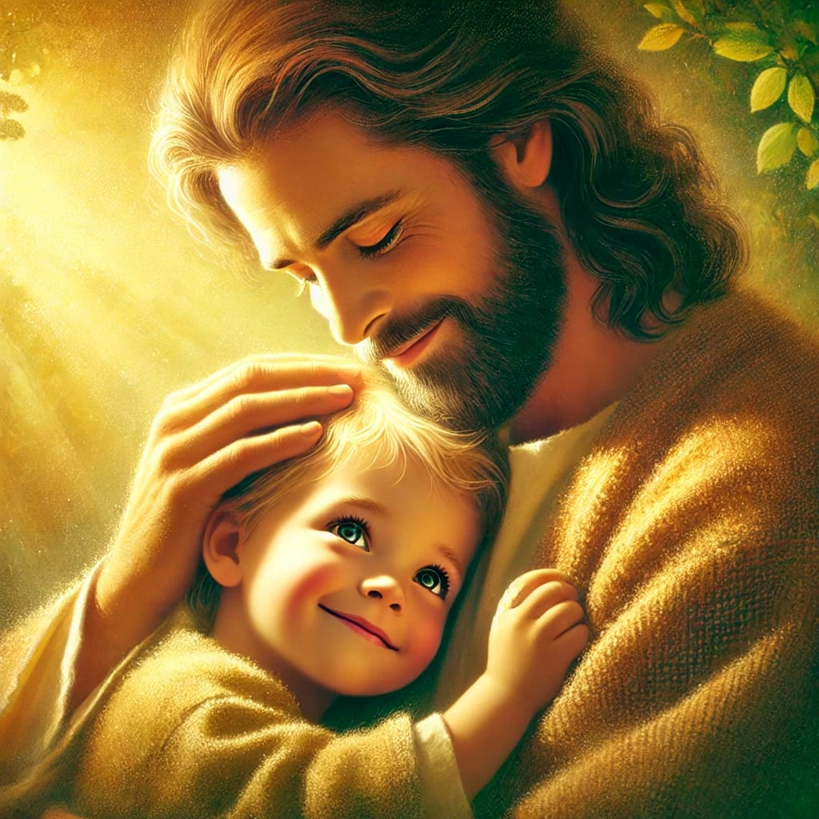

Slide 13
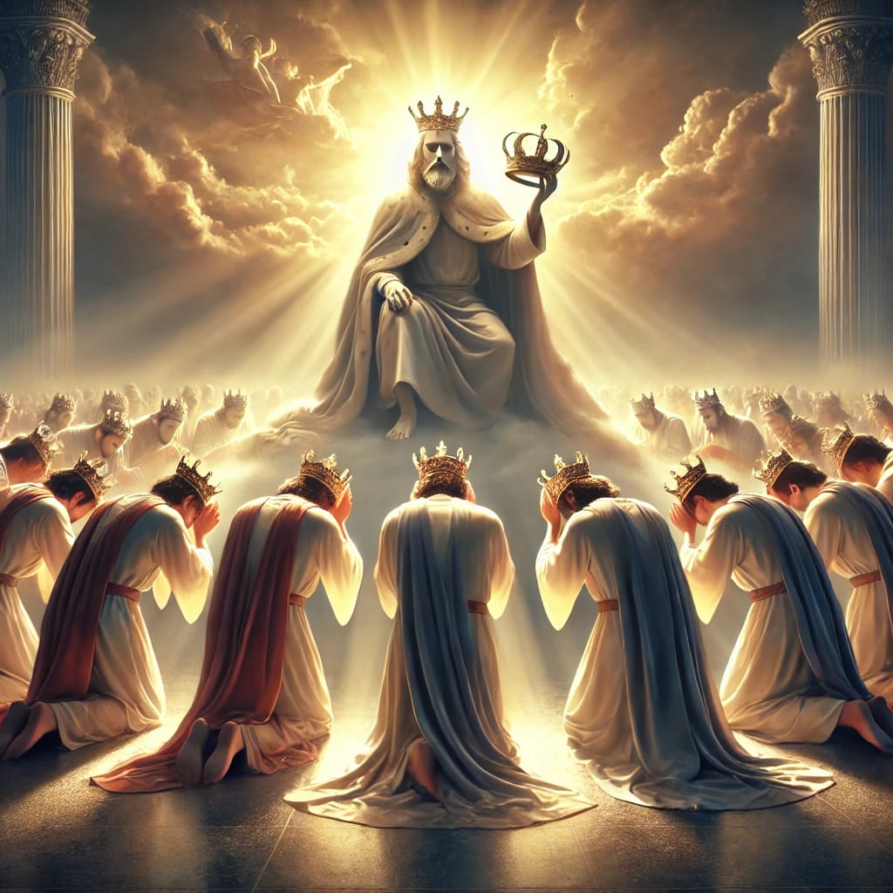

Slide 14
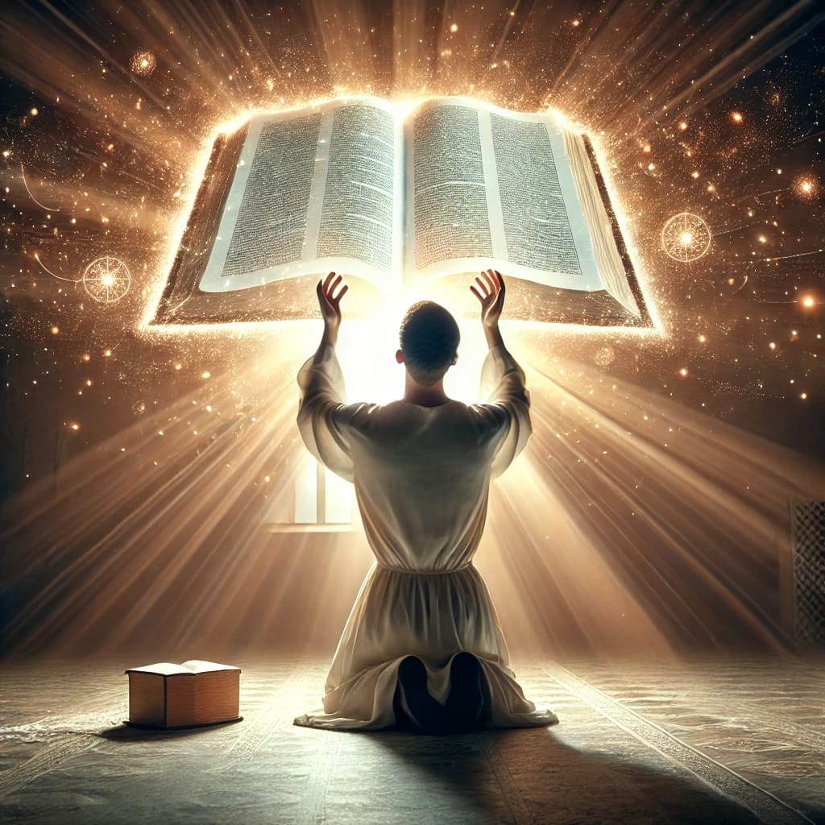

Slide 15


