Slide 1
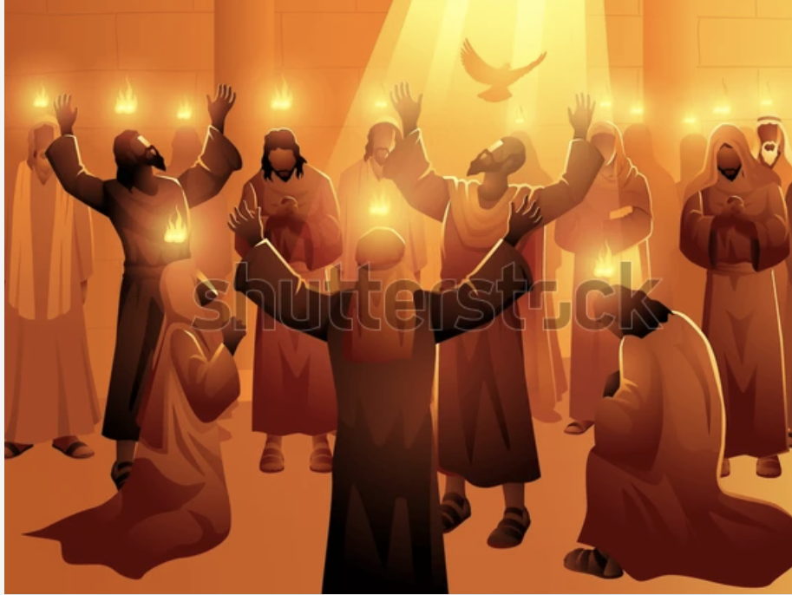
WHAT IS
THE
BAPTISM OF THE HOLYGHOST?

Slide 2
WHAT IS THE BAPTISM OF THE HOLYGHOST?
1) IT IS WHAT JOINS US WITH THE LORD (1 Cor. 6:16,17):
It is what joins us to the LORD to make us partake of His divine nature (2 Peter 1:4).

Slide 3
2) IT IS A FRUIT OF THE PROMISED LAND (Num. 13:23-27):
A fore-taste of glory divine (Eph. 1:13,14).

Slide 4
3) IT IS GOD’s SEAL OF OWNERSHIP AND SECURITY (Eph 1:13,14; 2 Tim 2:19):
A seal: Esther 8:8; Dan. 6:17; Eph. 4:30
Salvation, a process: Ezek. 36:24-27
Only the "finished work" will receive the seal.

Slide 5
4) IT IS THE SPIRIT OF TRUTH/REVELATION (Eph. 1:16-18; John 16:12,13; John 14:26):
You can't truly know God without the baptism of the HolyGhost.

Slide 6
5) IT IS THE POWER OF TRANSFORMATION (Acts 1:8; Luke 10:17-20; Luke 22:31,32).
6) IT IS THE GARMENT OF RIGHTEOUSNESS/WEDDING GARMENT (Rev. 19:7,8; Matt. 22:1-12).

Slide 7
7) IT IS THE MAKING OF A NEW CREATURE (2 Cor. 5:17; John 3:3-6; Psa 102:18)
In conclusion, the baptism of the HolyGhost is God coming in a man for the purpose of salvation.

