Slide 1
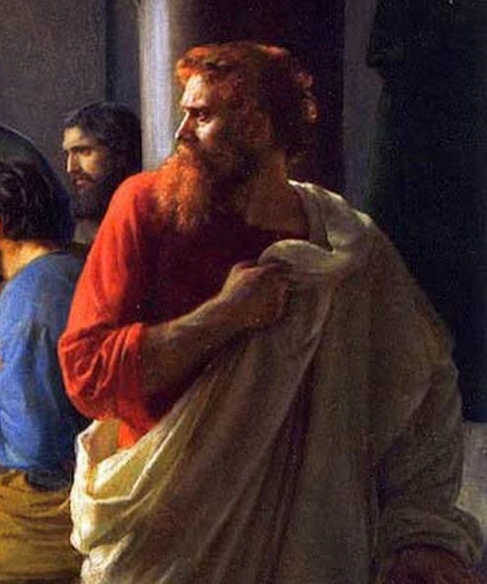
WHY JUDAS
CANNOT
BE CONDEMNED

Slide 2
Salvation is a mystery.
A mystery is something hidden or coded that you will need revelation to understand. 1 Cor. 2:6-8
Redemption was a mystery that even those who prophesied and fulfilled it didn’t understand. 1 Pet. 1:9-12
Before the coming of the Holy Spirit, men could not understand these mysteries. John 16:12,13
After the Holy Spirit came, God began to teach these mysteries to His church. Ephe 3:1-5

Slide 3
One of such mystery is the “MYSTERY OF GODLINESS”. 1 Tim. 3:16
Another is the “MYSTERY OF REDEMPTION”. 1 Cor. 2:7-8
How that before God can get us back, He had to offer up Himself. If Satan and the princes of this world knew, they would not have crucified Christ.
In bringing about this, God needed Judas.
To understand this great mystery, you have to look deeper beyond the surface

Slide 4
WHY JUDAS CANNOT BE CONDEMNED
God determined and planned the death of Jesus because it was the price for redemption. Gen 3:21, Isa 53, Acts 2:22-23; 3:18; 4:27-28
No man took the life of Jesus or had the power to, Jesus Himself offered His life. John 10:11-18, Luk 22:53, Acts 4:27-28, John 18:11 (Who delivered Him? -God), Matt 16:21-23; 26:51-56

Slide 5
Everyone involved in the death of Jesus were chosen for it like Joseph’s brothers – they did it ignorantly. Gen 45:1-8, Matt 10:21, Luk 23:34, Acts 3:17
The Chief priests representing the Jews
Pilate representing the Gentiles
Judas his associate.
Jesus prayed for the forgiveness of those involved in His death. Luk 23:34, Gen 50:15:21

Slide 6
The harsh statements of condemnation against Judas was Jesus speaking as a man. Matt 26:39-41 (The flesh is weak), Matt 26:21-29 (How will the blood be shed without Judas?), Luk 22:40-44, John 6:70-71
The idiom “son of perdition” describes one ordained to lead someone to destruction or loss physically/spiritually – Judas led to his physical loss. John 17:12

Slide 7
Judas’ sin was that he exposed the secret place of Jesus to His enemies. He had no idea they will condemn Him, he thought if they tried Him according to the law, they might let Him be. Mark 14:10-11, Matt 27:3-4.
He was not part of the plot to kill Jesus.
Judas repented and judged himself according to the law. Matt 27:3-5, Lev 24:17-21, Deut 19:21.

Slide 8
9. Judas was anointed to do what he did. John 13:1- 26 contrast Luke 22:31-34
10. Judas was fulfilling the law. Luke 24:13-27, Matt 5:17
Jesus did not deal with the weakness of Judas because of Rom 5:6-8.
God needed to demonstrate fully mercy and grace.

